Slide 1

Predicting Profanity in Humor with Random Forest Models
Meriel I. Burnett
Notes:
Ask yourself this: do you tend to swear when you’re joking around? I know that when I’m trying to be funny, I tend to use swear words. Why is that? Is that I’m young? Is it that I’m less agreeable? Or more extraverted? There’s a huge range of variables which might factor in, and what I’m interested in doing is finding out which variables are important to predicting swearing in your jokes. What I’ve done is trained a machine learning model – called a random forest- that autonomously evaluates the factors associated with swearing when making jokes.

Slide 2
Set up – punch line
‘Boring TV’ prompt | Your friend is raving about a new TV show and says you need to watch it. Later that week you start streaming it, but you can’t even make it through the first episode—the show is just too confusing and tedious.
Step 1. Prompt
Step 2. Set-up, e.g.,
“The TV show was so boring that” ________
Step 3. Participant Response, e.g.,
“…it’s a cure for insomnia”
“…the most exciting part was the credits”
Notes:
In order to study jokes, we first have to obtain them from people. We do this with a series of joke stem tasks, which are essentially funny interpersonal scenarios which prompt participants to generate jokes. It’s basically a fill-in-the-blanks response, where each joke stem ends with a set-up, and participants supply the punchline.

Slide 3
What factors are associated with profanity use in humor?
Procedure
n = 600 people from Prolific
2400 jokes (4 joke stems each)
Predictors
Openness
Conscientiousness
Extraversion
Agreeableness
Neuroticism
Humor efficacy
Humor identity
Humor background
Age
Gender
Ratings of how funny they thought their jokes were
Word length of each joke (on avg)
Outcome
Whether the person used profanity
- by cross-referencing a ~1600 word profanity database
-a binary outcome
Notes:
We gathered 600 people and gave them 4 joke stems each, for a total of 2400 jokes. We then coded these jokes for profanity. That is, we cross-referenced the text in people’s jokes with very large and shocking profanity dictionary. Matches between words in the profanity dictionary and words in people’s jokes were flagged as ‘profane’. The result was a binary variable – did the participant, or did they not use profanity in any of their jokes?
We also measured things that we think might help predict profanity use in humor – personality traits like openness, conscie, neuro, agreeableness, and extraversion, demographics like age and gender, traits related to their sense of humor, and how long each joke was. We don’t have any hypotheses, because this research is exploratory. As such, we are using an exploratory method.

Slide 4
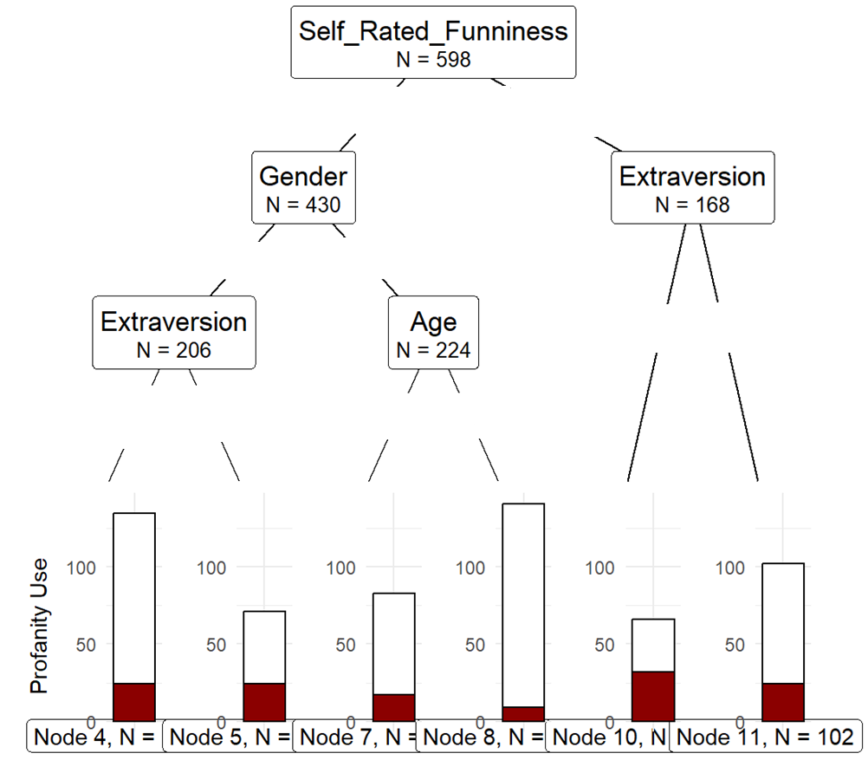
Conditional inference trees
Lower
Higher
What do trees do?
Divide participants into different outcome categories using a series of if-then rules based on predictor values.
Men
Women
How?
Step 1. See if any variables are significant, and if so, pick the most important predictor
Lower
Higher
Lower
Higher
Lower
Higher
Notes:
The approach we used relies on something called a conditional inference tree. The machine builds this tree using a few simple steps.
First, it searches for a significant predictor, and picks the predictor with the largest effect on the outcome.
In this case, self-rated funniness.

Slide 5
Conditional inference trees
Lower
Higher
What do trees do?
Divide participants into different outcome categories using a series of if-then rules based on predictor values.
Men
Women
How?
Step 2. Divide participants into bins of people with lower versus higher scores on that predictor
Lower
Higher
Lower
Higher
Lower
Higher
Notes:
It then divides participants into those with lower versus higher scores on that predictor. So, in this case, that’s people with lower versus higher self-rated joke funniness.

Slide 6
Conditional inference trees
Lower
Higher
What do trees do?
Divide participants into different outcome categories using a series of if-then rules based on predictor values.
Men
Women
How?
Step 3. For people within those bins (low vs high self-rated funniness), see if any variables are significant and pick the most important predictor
Lower
Higher
Lower
Higher
Lower
Higher
Notes:
It then asks again – are there significant predictors? If so, what’s the most important to predicting the outcome?
In this case, that’s gender for those lower in self-rated funniness, and extraversion for those higher in self-rated funniness.

Slide 7
Conditional inference trees
Lower
Higher
Step 4. Continue dividing participants into smaller and smaller bins until no more predictors are significant.
Step 5. Show proportion of profanity use for the participants in each terminal bin- “leaf”.
Men
Women
Lower
Higher
Lower
Higher
Lower
Higher
Notes:
The machine will keep making splits, dividing participants into smaller and smaller clusters, and thus obtaining more and more accurate predictions of whether or not participants within those clusters will use profanity in their jokes.
When there are no more significant predictors, it simply creates a ‘terminal bin’ or “leaf”, which shows the predicted outcome category of participants in that bin. For instance, people who didn’t think they were that funny, were female, and were older, were using very little profanity. Whereas, people who did think they were funny and who were extraverted, were using quite a bit of it.

Slide 8
Tree problems
Lower
Higher
Problem 1: Vulnerable to collinearity
Problem 2: Prone to overfitting, predictions generalize poorly
Men
Women
Lower
Higher
Lower
Higher
Lower
Higher
Notes:
These trees are really cool and easy to interpret once you get the hang of it. But we aren’t going to be interpreting a tree model, because tree models have a few major flaws that affect their reliability.
First, collinearity: when variables are highly correlated with each other, they can mask each other’s effect. For example, if self-rated funniness is collinear with another variable, then the fact that it appears at the top of this tree will essentially ‘block’ or ‘mask’ the effect of other variables which explain overlapping variance in the outcome.
Second, overfitting: which occurs when a model learns not only the underlying patterns in the data but also the error, the noise, the random fluctuations. This makes the model perform very well on the training data but poorly on new, and unseen data.

Slide 9
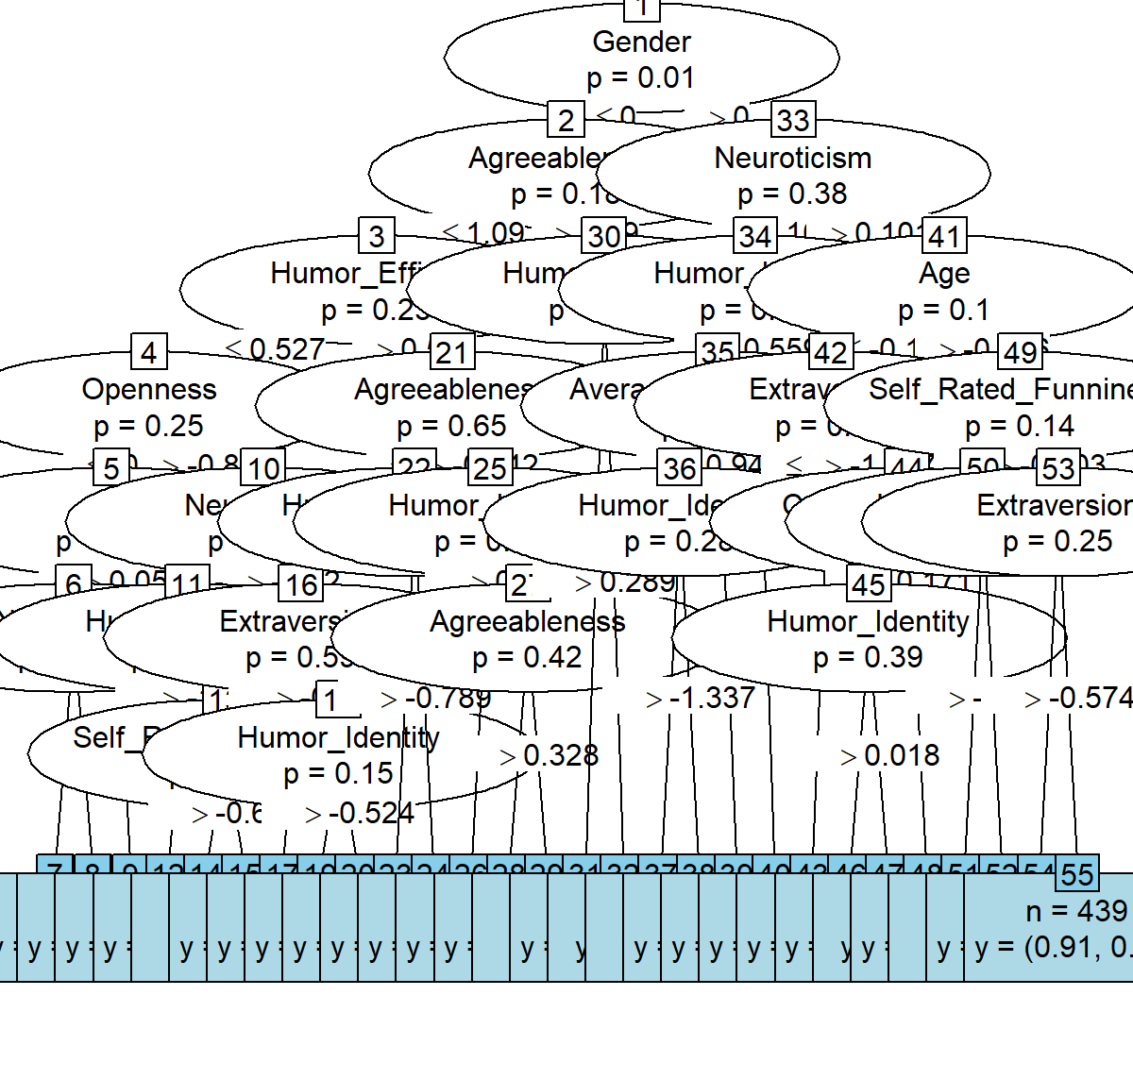
Random forests – combos of trees
Random forest: 10,000 trees
Notes:
We have a really cool solution to these problems. Instead of generating one flawed tree, we generate 10,000 individually flawed but uncorrelated trees. Because they’re all flawed in different, non-systematic ways, the overall predictions are very reliable. To ensure the trees are uncorrelated, we inject randomness into each. This results in with monstrous, random, Frankenstein trees. Looking at this, you might say, “wait a minute, how does this resolve collinearity, and isn’t overfitting gonna be an even bigger problem now?”

Slide 10
Random forests – combos of trees
Random forest: 10,000 trees
Each division only has access to a random 25% of predictors
Problem 1: Vulnerable to collinearity
Solution: Each split randomly samples from a subset (25%) of the total number of predictors
Notes:
Well, no, and here’s why.
Let’s start with how to resolve collinearity. We make it so that at each split – that is, each point at which the model divides participants into bins – only has access to a small fraction of the total number of predictors. For example here, the model has ‘gender’ as the top predictor, however the algorithm didn’t have access to all 12 of our predictors, it only had access to 25% of them. This is the same for each split, we provide a different random sample of 25% predictors available to the algorithm. In this way, we introduce predictor level randomness to the model.
This way, across 10,000 trees, each predictor will have a chance to shine in the presence and absence of other predictors. If gender masks the effect of age, that’s okay because at some point, the model will have access to age but not gender, thereby allowing age to effect the outcome.

Slide 11

Random forests – combos of trees
Random forest: 10,000 trees
Each tree is built on a random 60% of people, and tested on the other 40%
Problem 2: Prone to overfitting
Solution: Model fit estimates are based on the average of each tree’s predictive performance on participants it wasn’t trained on
Meet Gary – he wasn’t one of the 60% of participants used to train tree number 1387
Notes:
How about overfitting, how do we resolve this issue? Trees are also random on the participant-level. That is, the trees that make up a random forest are built on a random 60% of the total number of participants, and the remaining 40% of participants are used to validate them. Once the forest has been built – grown if you will – we see how good the model is at predicting profanity use for the participants it has not yet seen.
Here’s Gary. You may recognize him as the little guy from Google Earth. He wasn’t used to train tree 1387 which we will use as an example of how a random forest validates its predictions.

Slide 12
What gender is Gary?
Tree 1387
Notes:
We are going to follow Gary as he is sorted into a terminal bin based on factors about himself, like his demographic information and personality traits

Slide 13
Gary is male, so he goes into this bin
Tree 1387
Notes:
Gary is male

Slide 14
Gary is higher in Neuroticism, so he goes into this bin
Tree 1387
Notes:
Gary is higher in neuroticism – he’s a bit neurotic

Slide 15
Gary is lower in age, so he goes into this bin
Tree 1387
Notes:
Gary is lower in age – he’s young

Slide 16
Gary is lower in humor identity, so he goes in this bin
- A terminal leaf
Tree 1387
Notes:
Gary is lower in humor identity – he doesn’t consider humor a big part of his identity

Slide 17
Given that he is…
Male
Higher in neuroticism
Lower in age
Lower in humor identity
The tree predicts that he will use profanity.
Tree 1387
Notes:
Based on what the model knows about Gary, it thinks he will be a profanity user. That’s because for the people used to train this tree, the majority that were male, higher in neuroticism, lower in age, and lower in humor identity were profanity users.
So how does this resolve overfitting? Well, if the tree is overtrained, it will only be accurate when making predictions about the people it was trained on, in which case Gary, who wasn’t used to train the model, will rarely be sorted into the correct category. He will be considered a profanity user when he really isn’t, or vice versa.
Given that we have used new people to test each tree, the results you’re about to see reflect the effects that were important given a whole new sample. That is, my results reflect variables that we can be fairly confident are actually important to predicting profanity use in humor, and not just a fluke of my data.

Slide 18
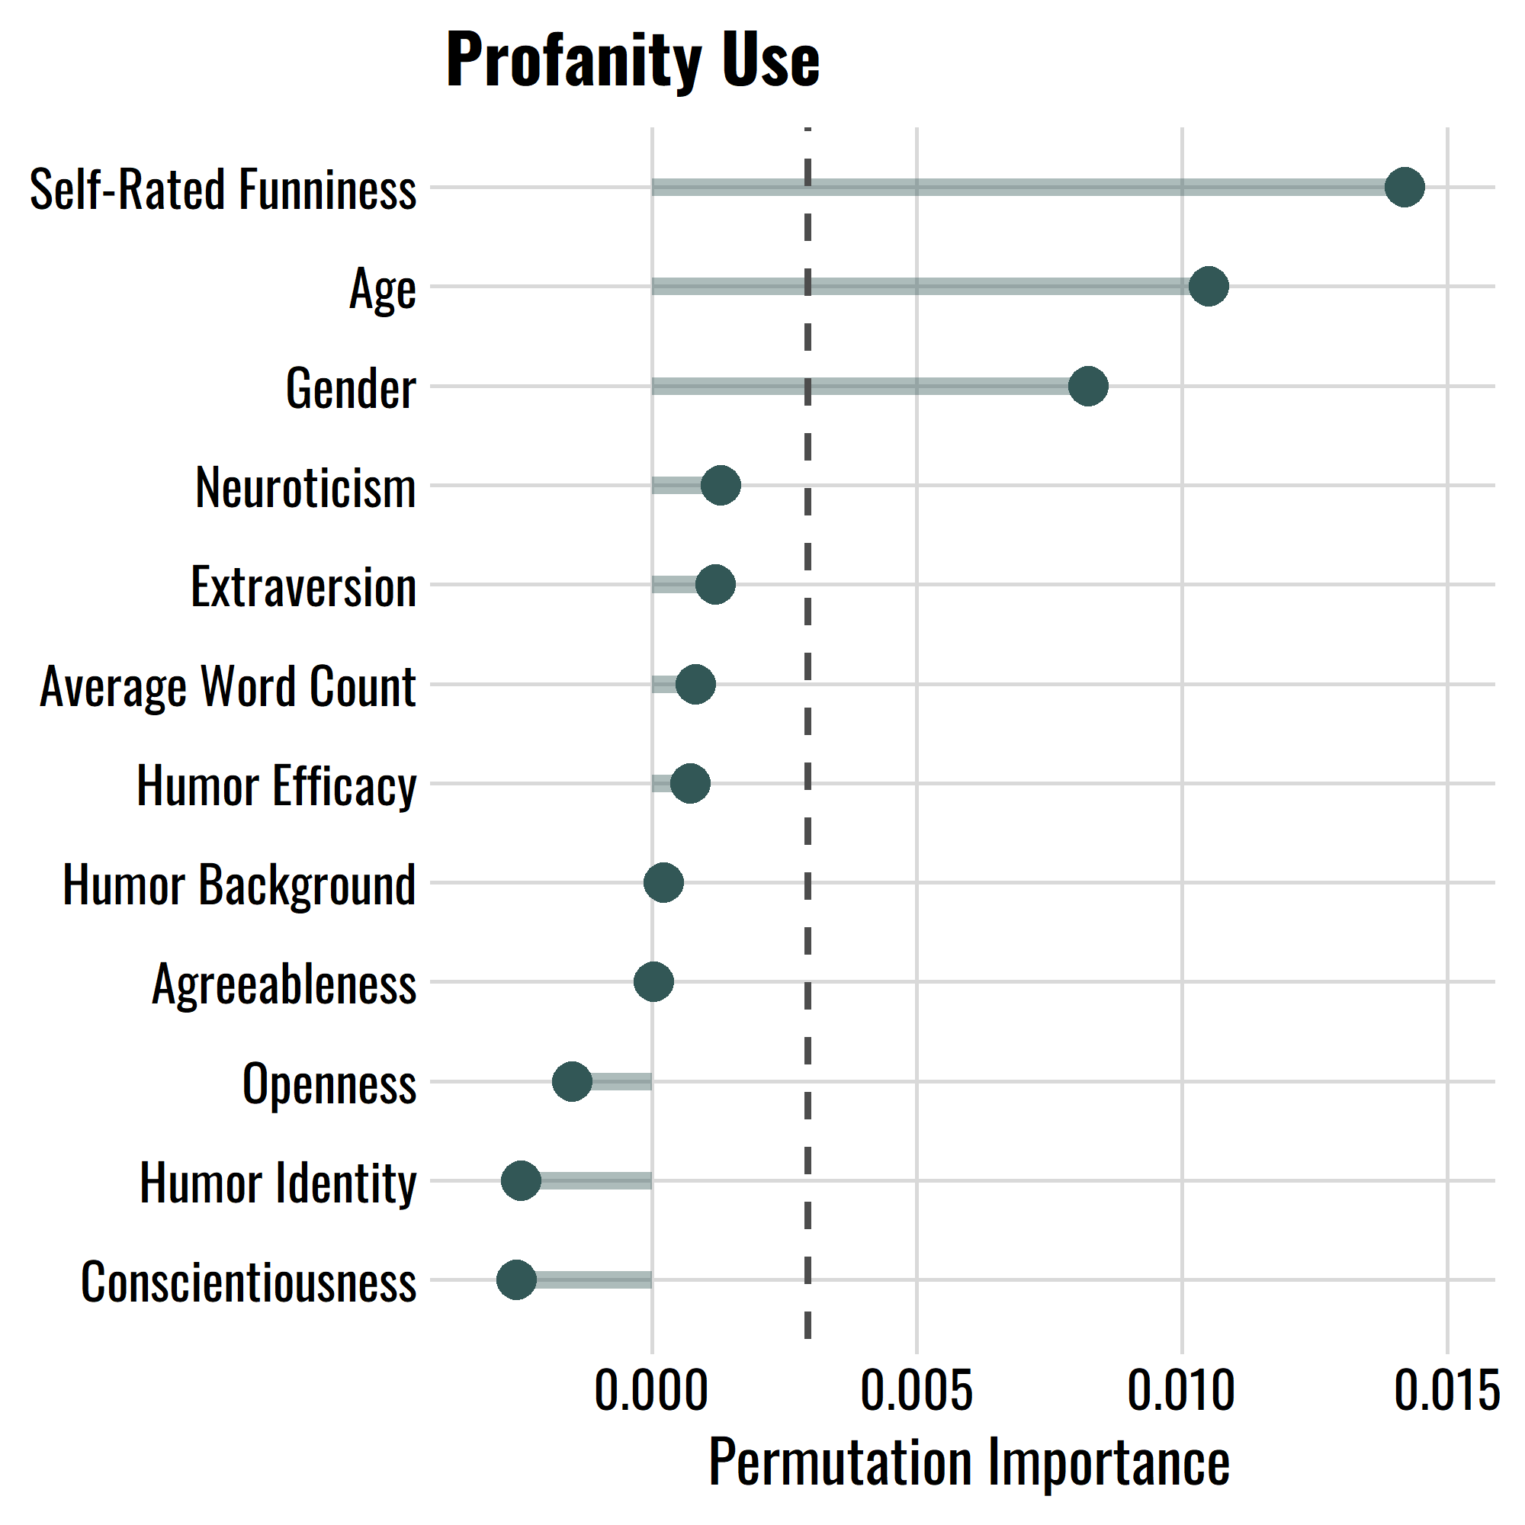
What predicted profanity use?
Notes:
It was hard enough looking at one of those trees, now it’s time to interpret the predictions of 10,000 of them. The output of a random forest is remarkably simple and easy to understand.
Results time: If you switched off during that descent into madness, you can switch back on now and you will still be able to understand what I’m about to say.
One output we get from a random forest is something called permutation importance. It shows us what predictors were important. What you need to know is that this plot ranks variables by their importance. This dashed line represents the chance level – anything beyond this line is important.
It determines whether something is important by seeing whether the model fit worsens when you randomly permute the values of that variable. E.g., how much more often does Gary get miscategorized, when we randomly reshuffle the values of age?
Based on this metric, we can see that self-rated funniness, age, and gender are the only important predictors of using profanity in your jokes.

Slide 19
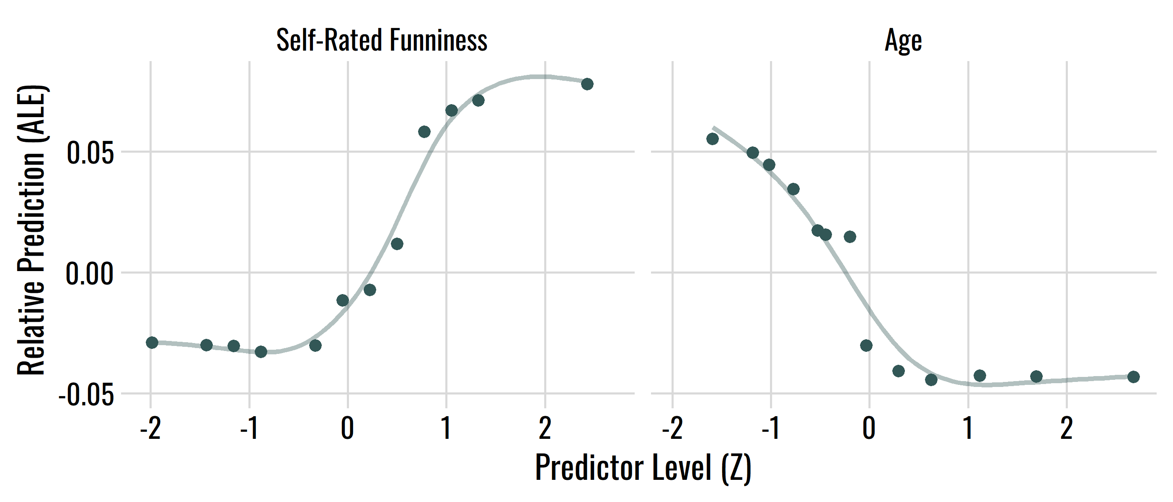
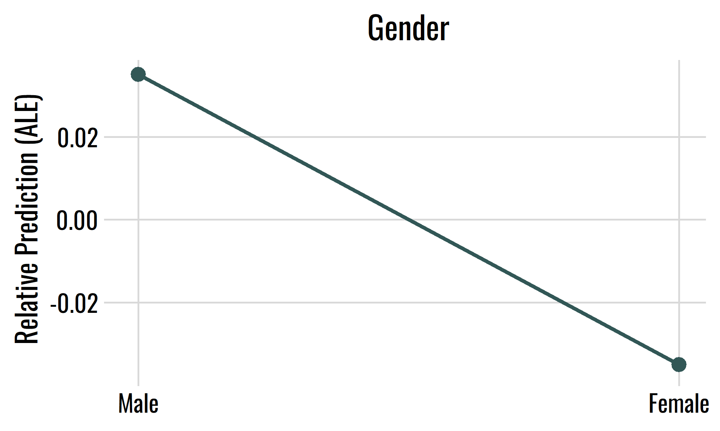
How did important predictors relate to profanity use?
Mean age = 35
Notes:
How did they relate to profanity use? The plots you see here are called accumulated local effects. You can interpret them in much the same way you interpret a regression or correlation plot. The predictors are standardized, meaning they have a mean of zero and a standard deviation of 1. The cool thing about accumulated local effects is that they show the non-linear relationship between your predictors and the outcome.
Those with higher than mean-level self-rated joke funniness tended to be the ones using profanity.
With age, it was young people – particularly those who were 1 to 2 standard deviations below the mean in age – who were predicted to use profanity. After a certain age, about 35ish, people just weren’t using swear words in their jokes.
Let’s not forget about gender. I don’t need to tell anyone how to interpret this plot. Unsurprisingly, men were more likely to use profanity than women

Slide 20
Discussion
Main findings
Swearing in jokes is related to…
Thinking your jokes are funny
Being male
Being young
MA Project
‘Dark side of personality’
Lots of profane jokes weren’t just profane, they were mean!
So let’s look at predictors related to meanness, e.g., sadism, psychopathy, and very low honesty-humility
However…
No personality variables were important
Therefore, we may be looking in the wrong place for predictors
Notes:
So let’s re-iterate our main results. It turns out that the primary factors related to using profanity in your jokes are
Thinking you’re funny
Being male
And being young
No personality vars were important. We might be looking in the wrong place for predictors. One clue is that many of the profane jokes weren’t just profane, they were really hostile – sexist, racist, and aggressive. This indicates that maybe we should be looking at predictors like sadism or psychopathy from the Dark Tetrad, or really low Honesty-humility from the HEXACO model.
That’ll be my MA thesis.

Slide 21
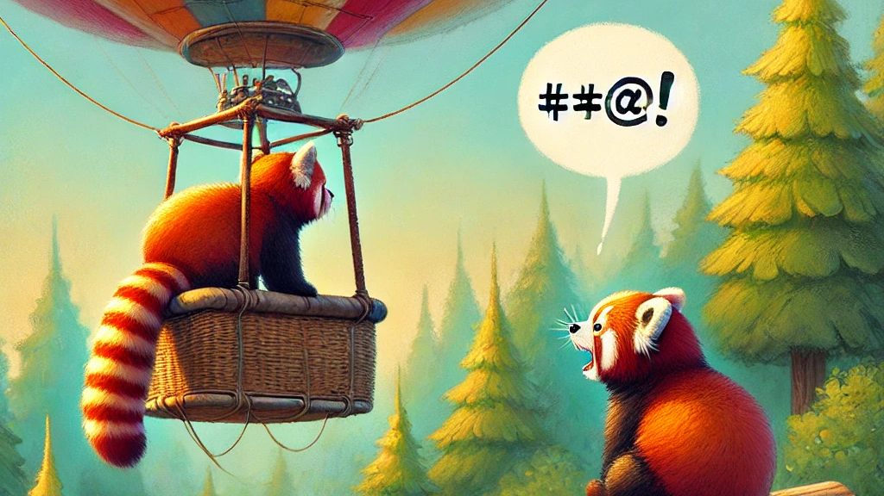
THE END

Slide 22
Joke prompts
Gross Food | Your friend invites you over and cooks dinner—and the food is totally disgusting.
Bad Singing | One of your friends wants your opinion on how well she sings. She sings a minute or two, and you cringe—she might be the worst singer you’ve ever heard.
Boring TV Show | Your friend is raving about a new TV show and says you need to watch it. Later that week you start streaming it, but you can’t even make it through the first episode—the show is just too confusing and tedious.
Dirty Car | A new friend is picking you up so you can go shopping. You haven’t seen their car before, so when it drives up you’re shocked—it might be the dirtiest, messiest car you’ve ever seen.
Notes:
In order to study jokes, we first have to obtain them from people. We do this with a series of joke stem tasks, which are essentially funny interpersonal scenarios which participants can use to generate humor. It’s a fill-in-the-blanks type response, where each joke stem ends with a set-up, to which participants supply the punchline.

Slide 23
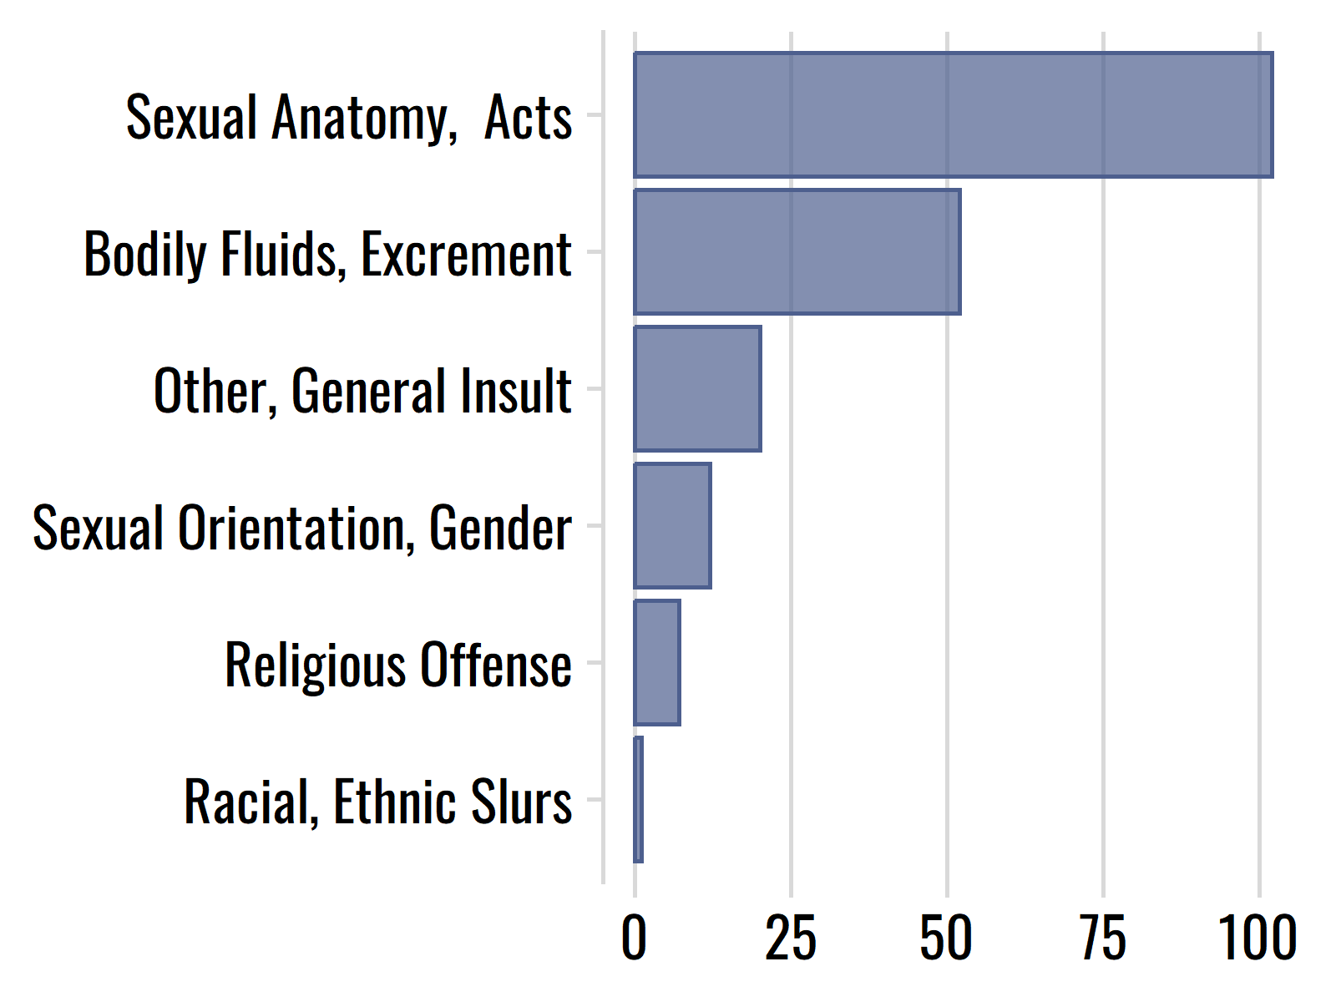
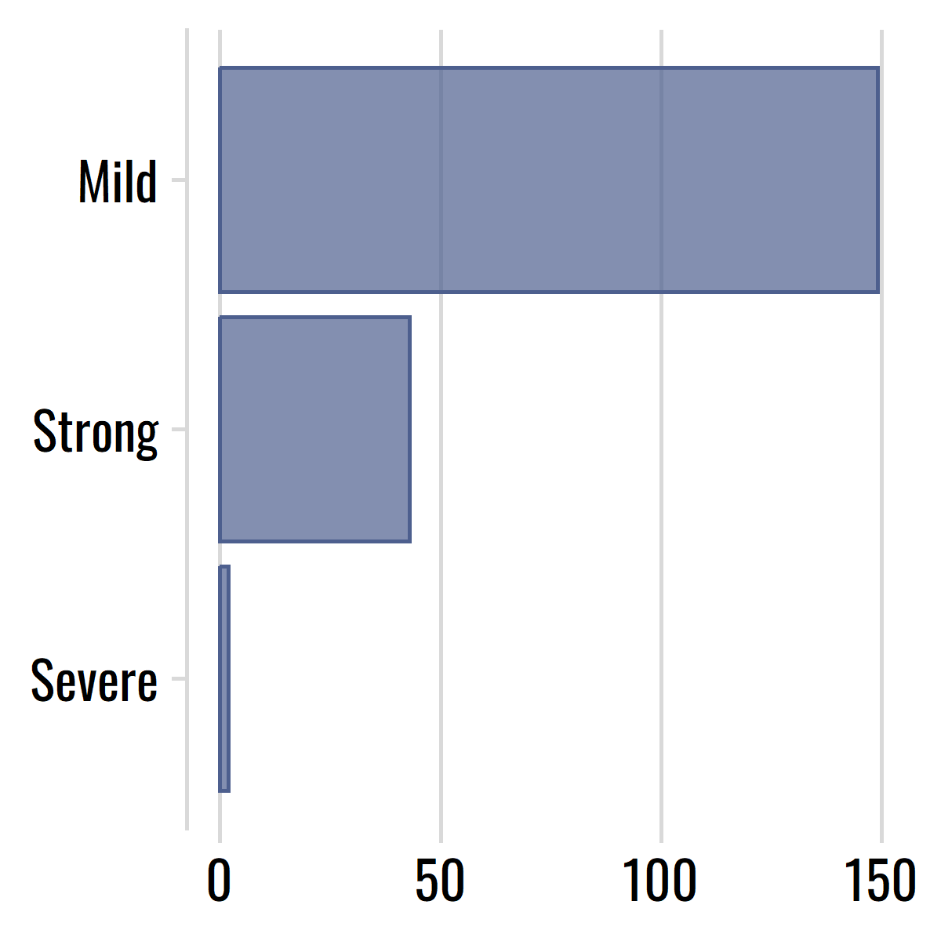
Findings: Frequency and Severity of Profanity
How common was profanity?
21.7% of the sample used profanity at least once
Of the 134 participants who used profanity…
71.6% used it just once
28.4% used it more than once
What kind of profanity did people use?
How severe was the profanity?

Slide 24
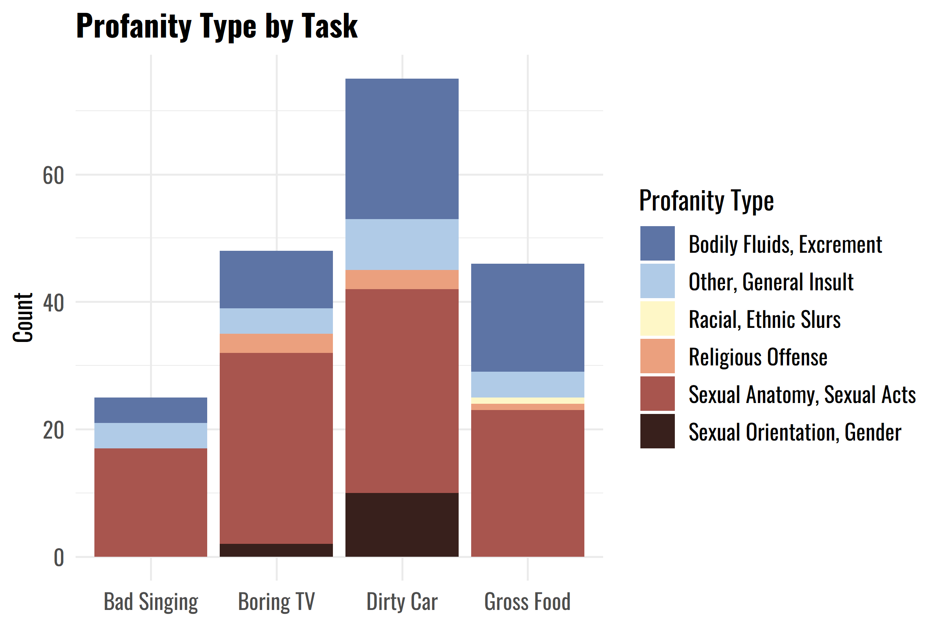
Findings: Types of Profanity by Task

